Slide 1
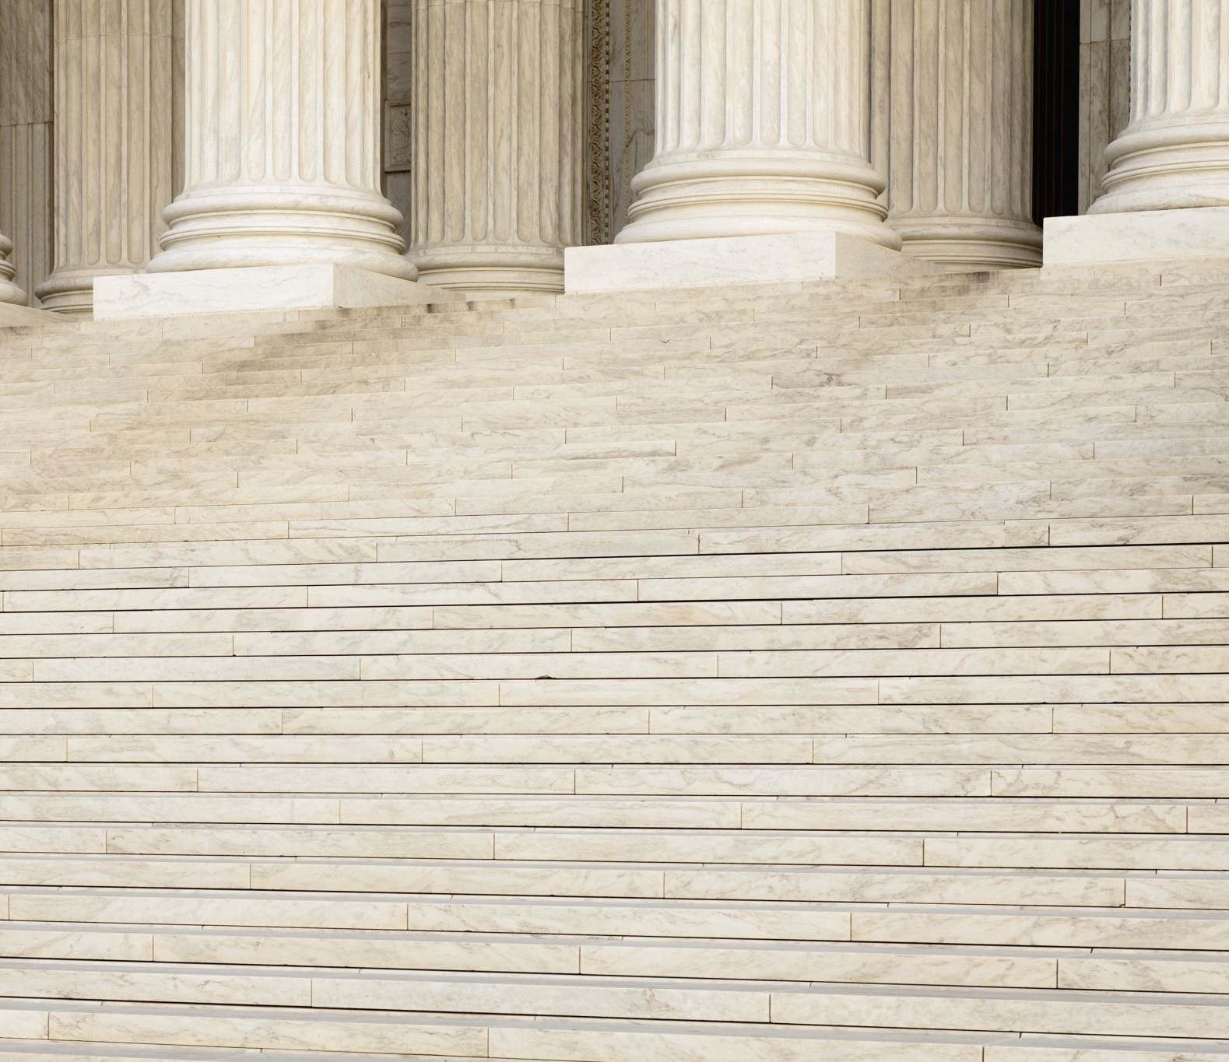
The Second Pillar
صلٰوۃ

Slide 2
Prove of five prayers in qura’an قرآن سے پانچ نمازوں کا ثبوت

Slide 3
Prayers in the light of Qura’an
وَ اَقِمِ الصَّلٰوۃَ طَرَفَیِ النَّہَارِ وَ زُلَفًا مِّنَ الَّیۡلِ ؕ اِنَّ الۡحَسَنٰتِ یُذۡہِبۡنَ السَّیِّاٰتِ ؕ ذٰلِکَ ذِکۡرٰی لِلذّٰکِرِیۡنَۚ (ھود )
And establish salah at both ends of the day, and in the early hours of the night.
اَقِمِ الصَّلٰوۃَ لِدُلُوۡکِ الشَّمۡسِ (بنی اسرأیل)
Establish salah at the time decline of the sun.
According to the Interpreters (مفسرین)
Both ends means “ the salah of fajr and asr.”
And in the early hous means “ the salah of maghrib and ishaa.”
At decline of the sun means “ the salah of Zuhar.
(Refrence Ma’ariful Qura’an)

Slide 4
Numbers Of Rakaat تعداتِ رکعت

Slide 5
NAMAAZ CHART
Prayer | Sunnat | Farz | Sunnat | Nafil | Wajib | Nafil | Total
Fajr | 2 (M) | 2 | --------- | -------- | --------- | -------- | 4
Zohar | 4 (M) | 4 | 2 (M) | 2 | --------- | -------- | 12
Asar | 4 (GM) | 4 | -------- | -------- | --------- | -------- | 8
Maghrib | -------- | 3 | 2 (M) | 2 | --------- | -------- | 7
Esha | 4 (GM) | 4 | 2 (M) | 2 | 3 (witr) | 2 | 17
Juma | 4 (M) | 2 | 4 (M) | 2 | --------- | --------- | 14
 |  |  | 2 (GM)

Slide 6
NAMAAZ CHART
Prayer | Detail
Eid | 2 raka’at wajib with 6 extra takbeerat without azan and iqamah no nafil / sunnat after and before.
Taraveeh | Taraawih namaaz is sunnat-e-muakkada for men and women in ramadaan only. The twenty rakaats of taraawih namaaz are performed after the farz and sunnat of esha. 20 rakaats with 10 salaams are masnoon. One should make niyyat for two rakaats of taraawih each time. Witr will be performed after taraveeh.
Janaza | 4 takbeerat farz, no azan & iqama.

Slide 7
Nafils (نوافل)

Slide 8
Nafils (نوافل) | Time and Raka’ats (رکعتیں اور اوقات)
Tahiyyatul Wudhu (تحیۃ الوضو ٔ) | After every fresh wudhu. (2 Raka’at)
Tahiyyatul Masjid (تحیۃ المسجد) | Whenever you enter the masjid.(2 Raka’at)
Ishra’aq (اشراق) | After 10 to 12 minutes following the sun rise (2 or 4 Raka’at)
Chashat (چاشت) | After about 1 ½ hours of sunsrise.( 4 to 12 Raka’ats even 2)
Awwabeen (اوابین) | After a fardh & sunnah of Maghrib (6 to 20 Raka’ats)
Thajjud (تہجد) | After midnight closer to Fajr (2 to 12 Raka’ats)
Salatut Tasbeeh (صلوۃ التسبیح) | Can be performed all the time except Makrooh time.(4 Raka’ats) سبحان اللہ والحمد للہ ولا الہ الا اللہ وللہ اکبر will be recitedlin every raka’at (total number of tasbeeh 300)

Slide 9
Timings Of Namaz (اوقات نماز)
Allah Almighty Stated
إن الصلاة كانت على المؤمنين كتابا موقوتا (نسا ٔ)
Salah is an obligation on the believers that is tied up with the time.
(و قیل) ای الاعمال احب الی اللہ قال الصلوۃ لوقتھا (بخاری)
Salah on prescribed time is loved in the sight of Allah

Slide 10
Timings of Namaz (اوقاتِ نماز)
Starting Time (ابتدائی وقت)
Preferred Time (مستحب وقت)
Ending Time (اختتامی وقت)

Slide 11
Namaz | Starts | Preferred | Ends
Fajr | After subha sadiq (early dawn) | Delay this namaz till spreading of light | Till sunrise
Zuhar | After zawaal (past noon) | Delay in summer and earlier in winter | The length of the shadow of an object becomes twice, excluding the original shadow
Asr | After the end of zuhar’s time | Delay till anyone can offer 2 or 4 Rakaat nafil | Till sunset
Maghrib | After sunset | As soon after sunset | When whiteness fades on the horizon(About 1 to 1.5 hour after sunset)
Isha | After dis-appearance the whiteness on horizon (about 1 to 1.5 hour after sunset) | one third of the night has passed | Till subha sadiq

Slide 12
Prohibited Times (ممنوع اوقات)
When sun is rising. (عینِ طلوع)
When sunset. (عینِ غروب)
When the sun is at zenith (عینِ زوال).
During above mentioned timing, any prayer is not allowed.
Except:
Asar of this day. (can be performed up to sunset)
Namaz-e-Janaza.(that came during this period)
Sajdah Tilawah. (that recited during this period)

Slide 13
Makrooh Times (مکروہ اوقات)
From Subh Sadiq to sunrise.
After Farz prayer of Asr, till the sun turns reddish.
During above mentioned timings, Performance of Nafil is not correct.
However:
Qadha Namaz,
Sajdah Tilawah,
Namaz-e-Janaza are allowed.

Slide 14
Conditions (شرائط) Of Namaz
These eight conditions are to be observed before Namaz.
these are called SHARAA’IT.(شرائط)
To make Wudhu if necessary.
To make Ghusl if necessary.
Taharah (cleanliness) of body and dress.
Taharah (cleanliness) of place.
Facing towards the QIBLAH.
Covering of the Satr (private parts).
Niyyah (intention) for Namaaz.
Performing Salaat at the prescribed times.
If any one of these conditions is omitted, Salaat will not be accepted.

Slide 15
Conditions (اَرکان) of Namaz
These six conditions are to be observed after Starting Namaz
these are called (ارکان)Arkaan.
Takbeere Tahrima.
Qiyaam (Standing Position).
Qiraat (Reciting Of At Least Three Aayats Or One Long Aayat Of The Quraan.
Ruku (To Bow Down).
Both The Sajdahs (Prostrate).
Qaa’dah Akheerah (To Sit So Long At The End Of The Last Rakaat That One Can Read The Tashahhud).
If any one of these conditions is omitted, Salaat will not be accepted.

Slide 16
Wajibaat (واجبات)
Waajibaat are those items that are necessary to complete the namaaz.
If one omitted, or delay any one of them unknowingly, this mistake can be compensated by performing sajda sahw (سجدہ سہو) (sajda done for mistakes made unknowingly).

Slide 17
Waajib (واجبات) Of Namaz
Fixing the first two rakaat of the farz namaaz for qiraat.
To Recite surah faatiha in all the rakaat of each namaaz. except third and fourth rakaat of farz namaaz.
To recite any small surah or three small aayats or a one lengthy aayat after surah faatiha in all the rakaat of each namaz i.e.(sunnat, Nafil & first 2 rakat of farz.

Slide 18
Waajib (واجبات) Of Namaz
To read sura fatiha before any other surah or aayat
To maintain order (ترتیب) between qiraat, ruku,and sajda.
Qauma (قومہ) (standing up erect after ruku).
Jalsa (جلسہ) (sitting between the two sajdas).
Ta'deele arkaan (تعدیل ارکان), i.e. Performing ruku, sajda, etc with contentment and in proper way.
Qaadah-oolaa (قعدہ اولی) or sitting to the extent of saying tashahhud (تشھد) after two rakaats in namaaz of three or four rakaats.

Slide 19
Waajib (واجبات) Of Namaz
To read tashahhud in the two qai'daas.
To recite qiraat aloud (قرأت باالجھر) in fajr, maghrib, esha, jumuah, eidain and taraweeh in ramadaan by the imam. The imam should recite zohar and asr silently (قرأت باالسر).
To end the namaaz by saying ‘(السلام علیکم ورحمۃاللہ)'
To say takbeer (اللہ اکبر) for qunoot in witr namaaz and also recite dua-e-qunoot (دعا ِٔ قنوت).
To say six additional takbeers in both eid namaaz

Slide 20
Sunnats Of Namaz (نماز کی سنتیں ) Sunnats are factors which performed by Rasoolullah (SW) He who performs the namaz according to the Sunnat Acts, gets full reward by Allah Almighty.

Slide 21
Sunnat Acts Of Namaz (سنتیں)
To raise the hands up to ears before saying takbeere tahreema.
Everybody leaving fingers open, at ease, and facing the qiblah.
Not bowing the head when saying takbeer.
Loud recitation of all takbeers (اللہ اکبر) by the Imam.
In qiyaam (قیام) place right hand upon left hand and men place them below navel.
Saying (ثنا ٔ).
To recite ta'awwuz. (اعوذ با اللہ من الشیطن الرجیم)
To recite the complete bismillah. (بسم اللہ الرحمن الرحیم)

Slide 22
Sunnat Acts Of Namaz (سنتیں)
To recite only surah fatiha in the third and fourth rakaats of fardh namaaz.
To recite ثنأ , تعوذ and آمین after fatiha softly.
To recite as much qiraat as is sunnat for every namaaz.
To say تسبیح thrice in ruku and sajdah.
To keep the back and the head in same level while holding the knees fingers of both the hands in ruku.
To say سمع اللہ لمن حمدہ and then ربنا لک الحمد by imam and only ربنا لک الحمد by muqtadi (مقتدی) in قومہ.
The munfarid (منفرد) should say both (تسمیع) and (تحمید).

Slide 23
Sunnat Acts Of Namaz (سنتیں)
Performing sajdah prostrate on the ground with your knees first, then place both hands and then fore-head touching the ground.
During jalsa and qaidah place both hands on thighs in the sitting position.
In تشھد praise the fore-finger of the right hand at اشھد ان لا الہ and down at الا اللہ .
Recitation of Drood shareef after تشھد .
Recitation of Dua after Drood shareef.
For salaam, first turn to the right side and then to the left side....

Slide 24
Mustahab (مستحبات) There are 5 Mustahabs (preferable) in Namaaz

Slide 25
Mustahab (مستحبات)
To pull the PALMS out of the SLEEVE while saying TAKBEERE TAHREEMA.
Saying TASBIH more than THREE times in RUKU and SAJDAH by MUNFARID.
To keep the EYES towards the place of SAJDAH in QIYAAM at the TOES in RUKU towards the LAP in QA'IDAH and JALSA, and at the SHOULDERS while turning for SALAAM.
To try best NOT to COUGH.
To try and keep the MOUTH CLOSED when YAWNING, but if it is OPENED, to COVER it by the UPPER portion of the RIGHT HAND in QIYAAM and by the LEFT HAND in all other postures.

Slide 26
Mufsidat (مفسدات) Of Namaz
Mufsidaat-e-namaaz are factors which invalidate
(فاسد) the prayers (namaaz) and make it necessary to be repeated.

Slide 27
Mufsidat (مفسدات) Of Namas
To talk in namaaz intentionally or unintentionally. a few words or many will invalidate the namaaz.
To greet a person by (السلام علیکم) or by any other way while performing namaaz.
To reply to greetings or saying (یرحمک اللہ) to one who sneezes and saying ameen to a dua not connected to his namaaz.
To say (اناللہ وانا الیہ راجعون) on some sad news or (الحمد للہ)or (سبحان اللہ) on hearing some good or strange news.

Slide 28
Mufsidat (مفسدات) Of Namas
To make noise or say "oh!" Or "aah!" Due to pain etc.
Correcting the qiraat of a person other than his own imaam.
To recite the quraan by looking at the text.
To do such an act which gives the impression to out lookers that he is doing something else rather than performing namaaz. This, is called amale katheer. (عمل کثیر)
Eating or drinking intentionally or unintentionally.
To turn the chest away from the qibla without an excuse.
Doing sajda at a najis place.

Slide 29
Mufsidat (مفسدات) Of Namas
Delay in covering the satr (private parts) when uncovered to the extent of performing one rukn in namaaz.
Laughing aloud.
To step ahead of the imaam during the namaaz.
Making some immense error (لحن جلی) in the qiraat of the holy quraan.

Slide 30
Makrooh (مکروہات) Doing of a MAKRUH act in Namaaz causes the full blessing of the Namaaz to be lost although the Namaaz will not have to be repeated.

Slide 31
Makrooh (مکروہات)
Saying NAMAAZ BARE-HEADED due to LAZINESS or CARELESSNESS and to EXPOSE the ARMS ABOVE the ELBOWS.
PLAYING with CLOTHES or the BODY.
Performing Namaaz in CLOTHES in which people do NOT ORDINARILY LIKE to go OUT.
To dust the floor with one's hands to prevent the soiling of clothes.
Performing Namaaz when one has the URGE to URINATE or PASS STOOL.
To CRACK one's FINGERS or PUTTING of FINGERS of one hand into FINGERS of the other HAND.
TURNING the FACE away from QIBLA and LOOKING AROUND.
It is MAKROOH for MEN to REST BOTH the ARMS and WRISTS on the GROUND in SAJDAH.
Performing Namaaz when another person FACING him sits AHEAD.

Slide 32
Makrooh (مکروہات)
Yawning intentionally and not preventing it, if one can do so.
Closing the eyes, but if it is done to concentrate in namaaz, it is allowed.
It is makrooh for a Adult (بالغ) person to stand alone behind a saff (row) when there is place in the saff before him.
Performing namaaz in clothes with pictures of living objects on them.
Performing namaaz at a place where there is a picture of a living (animate) object above or on the right or left side of the namaazi or on the place where he makes sajdah.
To count aayats, suras or tasbihs on fingers in namaaz.
Performing namaaz with a sheet or clothes wrapped on the body in such a way that it makes it difficult to free the hands quickly.
To yawn and stretch arms to remove laziness.
Doing something against sunnat in namaaz.

Slide 33
نمازِ سفر

Slide 34
The Traveler's Namaaz (مسافر کی نماز)
In shari'at (شریعہ) a person who intends to travel a distance of 77 kms (48 miles) or more, is called a musaafir (مسافر).
A person who travels 77 kms or more and intends to remain at one's destination for less than 15 days, is also a musaafir.
A musaafir who intends remaining at his destination for 15 days or more will only be a musaafir during his journey. Once he reaches his destination, he will not be a musaafir.

Slide 35
The (Traveler's) Namaaz (مسافر کی نماز)
A musaafir should make qasr (قصر) of the zohar, asr and esha (farz only), i.e. One must perform two farz only instead of four rak'aats.
There is no qasr in the farz of fajr and maghrib. Similarly there is no qasr of witr, sunnat or nafil salaat.
A musaafir who performs his namaaz behind a muqeem (مقیم) imaam (who is not a musaafir) should perform the full four rakaats in the zohar ,asr and esha farz.

Slide 36
The (Traveler's) Namaaz (مسافر کی نماز)
If the imaam is a musaafir and muktadi is muqeem, the musaafir imaam should complete his namaaz after two rakaats and there after he must ask the muqeem muktadis to complete their namaaz by saying:
"complete your namaaz, i am a musaafir"
then muqeem muktadis should stand up and complete the remaining two rakaats without reciting surah faatiha or any other surah.

Slide 37
Salaat with Jamaat (جماعت)
Jamaat is the performing of salaat by two or more than two persons collectively.
Jamaat consists of at least two persons: the imam and the muqtadi. muqtadi should stand at the right of the imaam in such a manner that the toes of the muqtadi should be parallel to the ankle of the imaam.
To perform the five daily salaat with jamaat is waajib.
The reward of jamaat in the masjid is twenty seven times greater than performing alone.
Muslims meet five times a day and this creates love and unity.
It is not wajib upon women children, sick persons, those nursing the sick, very old persons and the blind to attend the jamaat.

Slide 38
Misconception About Namaz
What is the use of such a Namaz when it cannot stop from committing wrong things such as theft in weighing and measuring, cheating, oppressing his subordinates etc..
If one cannot be an ideal Muslim even after Namaz, it is better to remain non-worshipper.
It means….,
If any patient doesn’t take medicines according to the prescription, can we say him that it is better to leave the treatment?
Either the patient is responsible or we make guilty to medicines?
The question “if we don’t become an ideal Muslim even after Namaz it is better to remain non-worshipper.” Such question will raise on all Ebadaats also, but it is not correct.

Slide 39
Conclusion
The right way is that “Ebadaat which will be performed according to the instructions of the Holly Prophet (sw) will refrain us from wrong things”.
As stated by Holly Prophet (sw) :
صلوا کما رایتمونی اصلی
Pray (perform Namaz) as you have seen me.
According to the Hadith “Rasoolullah (sw) was said to a person who spend their nights in namaz but mornings ln theft that…,
“one day his namaz will refrain him from theft”.
Therefore we should not leave the namaz in any cost.

Slide 40
Benefits Of Namaz
Refrainment from unlawful / forbidden things.
وَ اَقِمِ الصَّلٰوۃَ ؕ اِنَّ الصَّلٰوۃَ تَنۡہٰی عَنِ الۡفَحۡشَآءِ وَ الۡمُنۡکَرِ (العنکبوت)
Self Discipline.
Brotherhood and equality.
استووا ولا تختلفوا فتختلف قلوبکم (مسلم)
Humiliation and Supplication before Allah.
ولذکر اللہ اکبر (العنکبوت)
ان احدکم اذا صلی یناجی ربہ (بخاری)
To Remind the purpose of life.
وَ مَا خَلَقۡتُ الۡجِنَّ وَ الۡاِنۡسَ اِلَّا لِیَعۡبُدُوۡنِ ﴿۵۶﴾ مَاۤ اُرِیۡدُ مِنۡہُمۡ مِّنۡ رِّزۡقٍ وَّ مَاۤ اُرِیۡدُ اَنۡ یُّطۡعِمُوۡنِ ﴿۵۷﴾

